Slide 1

Google Cloud Essentials for Developers and Career in Cloud Computing
Irine Kokilashvili for GDG ELTE
March 2025

Slide 2


About me
Platform Engineer @ Space International
Public Speaker
Podcast Host

Slide 3

What is Shipping Code & Why Do We Ship to the Cloud?
Shipping code is the process of moving your app or website from your personal computer to a publicly accessible location, like the cloud
Notes:
What is Shipping Code & Why Do We Ship it”
"Imagine you’re working on a mobile app or a website. You spend hours writing code on your laptop, designing the perfect user experience, and testing it to make sure everything works. But there’s one problem—right now, it only exists on your computer. No one else can see or use it."
"If you want your app or website to be available to people all over the world, you need to move it to a place where anyone can access it. This process of moving your code from your personal computer to a publicly accessible location is called ‘shipping code.’"

Slide 4
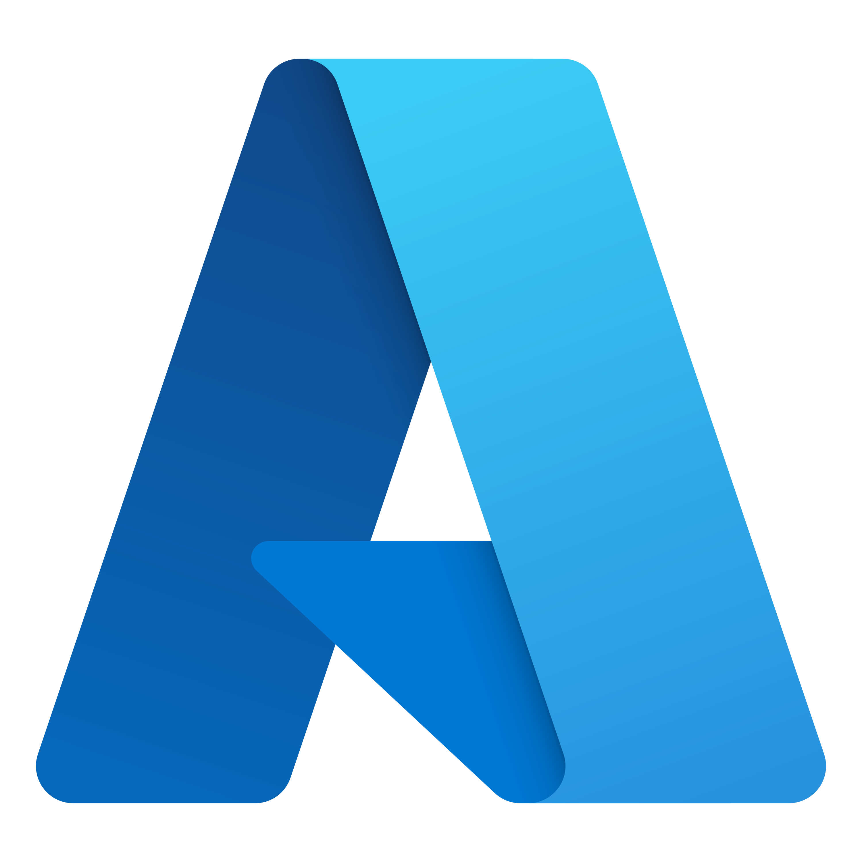

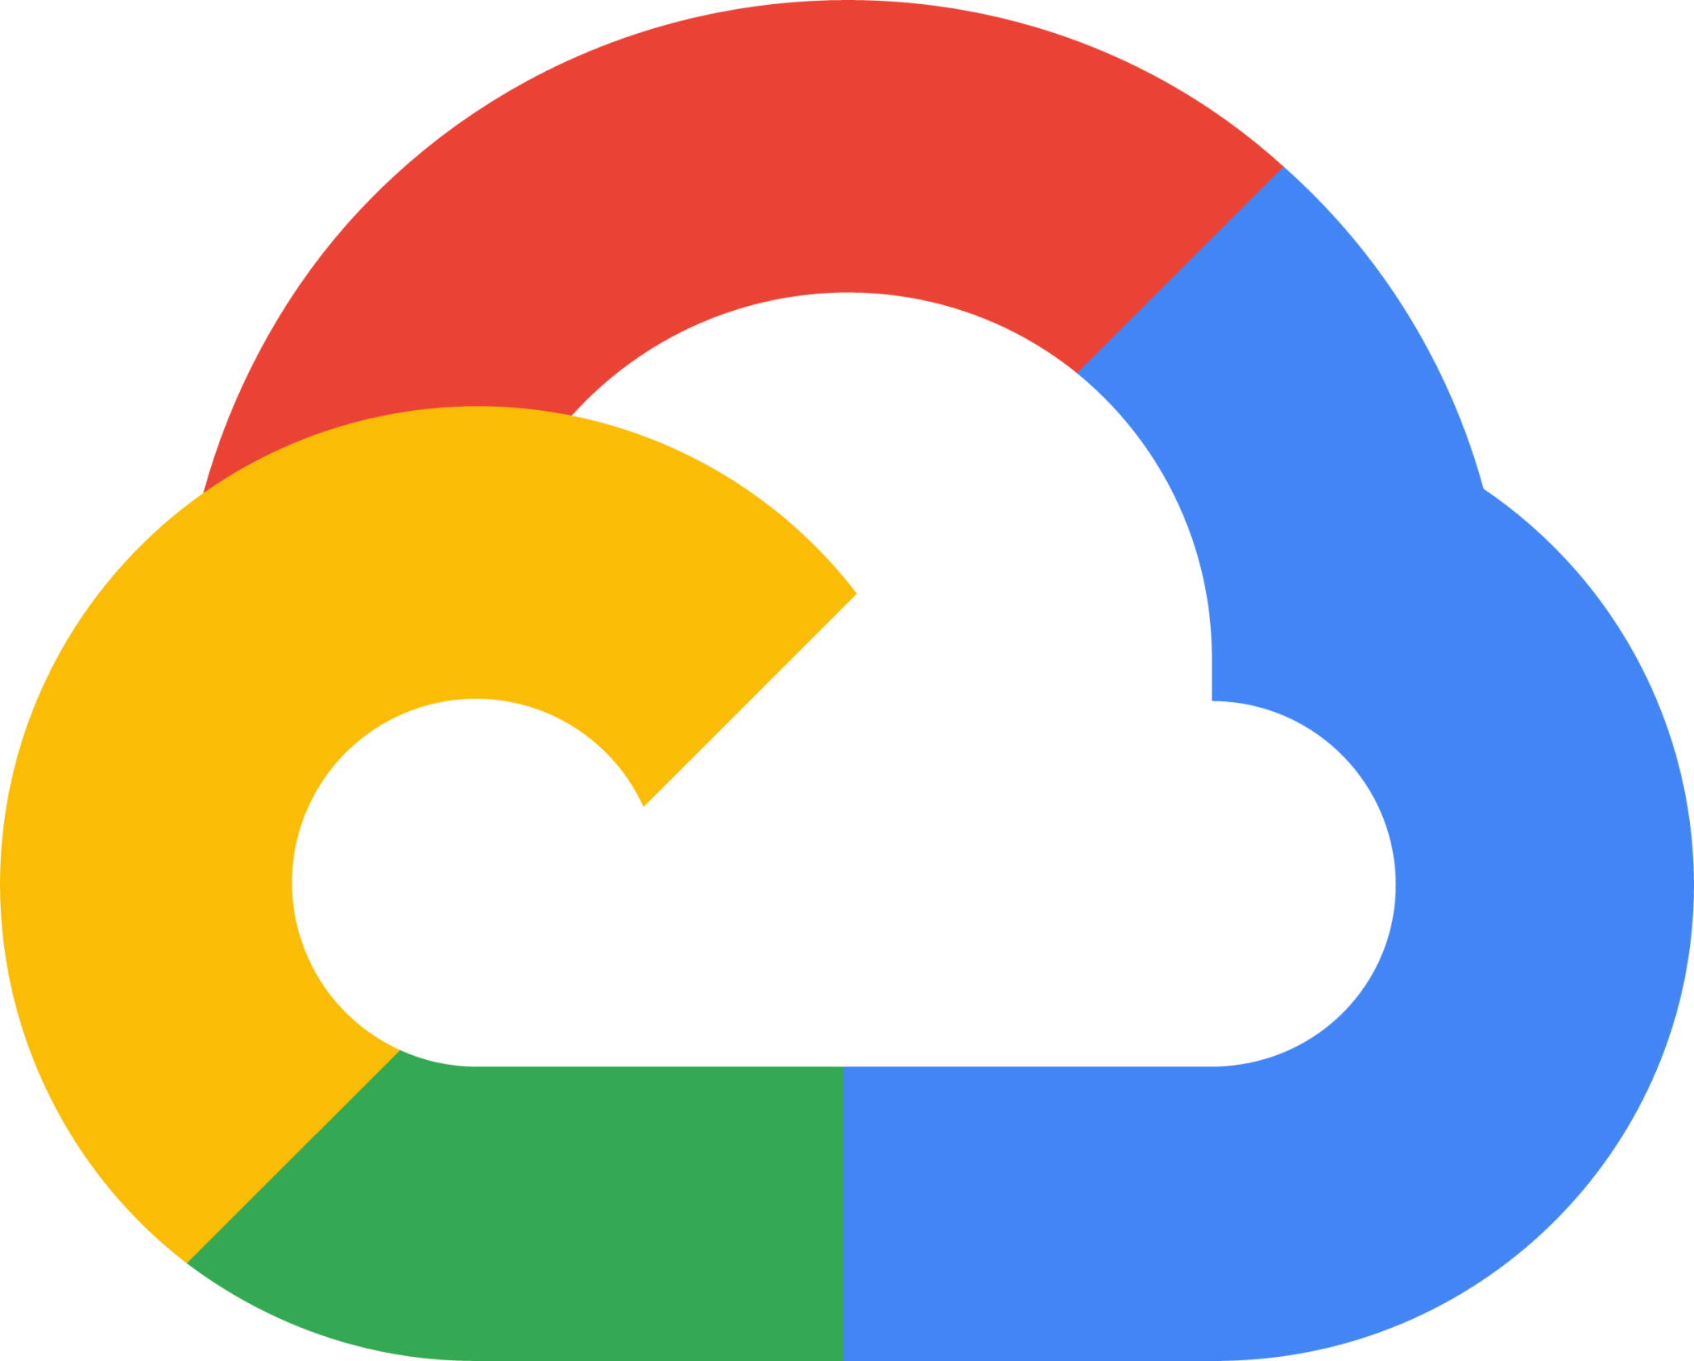
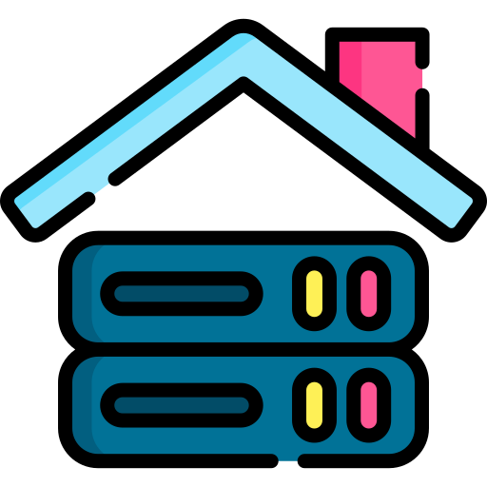
Why Do We Ship Code to the Cloud?
Your computer isn’t always on
Your internet connection isn’t built for handling many users
You’d have to fix issues manually
On-prem (on-premises) refers to running software and storing data on physical servers located within your own facility, rather than using cloud services.
Notes:
One way to make your app available is to run it on your own computer and give people access. But that wouldn’t work well because:
Your computer isn’t always on – If you turn it off, your app goes offline. Your internet connection isn’t built for handling many users – If too many people try to access your app, it could slow down or crash. You’d have to fix issues manually – If something breaks while you’re away, no one can use your app until you return to fix it.
This is why we ship code to the cloud. Instead of running your app on your personal computer, you upload it to a cloud provider like Google Cloud, AWS, or Azure, where it runs on powerful servers that are always online, can handle lots of users, and automatically scale up if needed.
You can also opt out for on prem

Slide 5
Why Not Just Click Buttons to Ship?
You had to do this every time you made a small change
You had to do this for 100 different projects every day
You forgot one small step, and everything broke
Notes:
Okay, so now we know we need to move our app from our computer to the cloud. One way is to log in to Google Cloud, click some buttons, upload files, and set things up manually. But imagine if:
You had to do this every time you made a small change.
You had to do this for 100 different projects every day. You forgot one small step, and everything broke.
That would be a nightmare, right?
This is where CI/CD comes in. Instead of doing everything manually, we write instructions (like a recipe for our pizza) and let a system handle it automatically. CI/CD ensures that every update gets tested, packaged, and deployed without us clicking buttons.

Slide 6
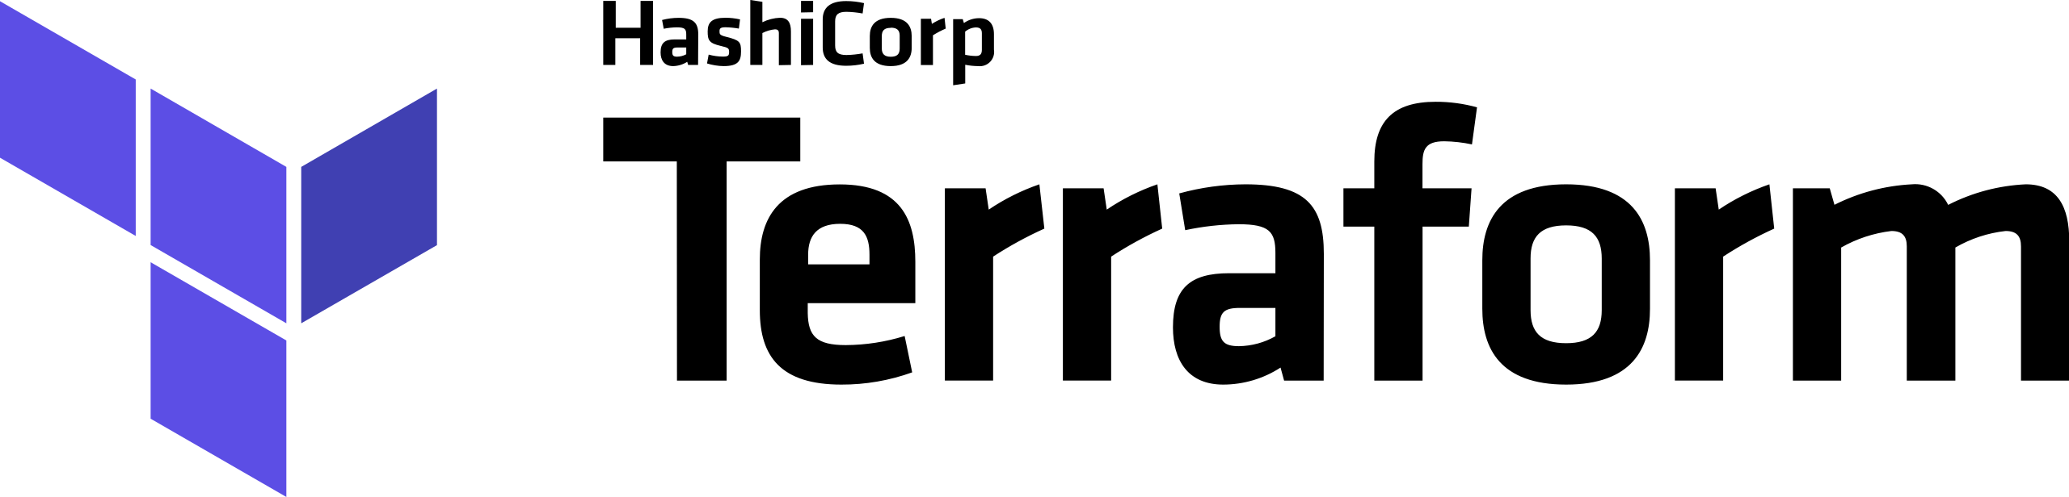
How We’ll Get Our Code from Local to Google Cloud
What resources we need, like servers or databases
How to set them up with the right permissions, networks, etc.
And Terraform will automatically create those resources for us in Google Cloud
Infrastructure as Code (IaC) IaC is the practice of managing infrastructure using code, instead of manual configuration.
Notes:
First up, we have Terraform. This is a tool that allows us to define our cloud infrastructure as code. Instead of clicking around in the Google Cloud Console to set up servers, databases, or networking, we use Terraform to write down exactly what we want in a configuration file.
This configuration file tells Terraform:
What resources we need (like virtual machines or storage buckets)
How to set them up (with the right permissions, networks, etc.)
And Terraform will automatically create those resources for us in Google Cloud.
In other words, Terraform is how we automate the setup of our cloud infrastructure, ensuring everything is created in a repeatable and consistent way.

Slide 7

How We’ll Get Our Code from Local to Google Cloud
Run tests to make sure our code works
Run Terraform to create or update the infrastructure
Deploy the updated app to Google Cloud, all without us clicking a single button.
GitHub Actions takes care of the automation, making sure our app is deployed smoothly every time we make a change.
Automation/Consistency/Integration with GitHub/Faster Updates
Notes:
Next, we have GitHub Actions. This is a tool that automates workflows directly in GitHub. It lets us set up a series of steps to automatically trigger when we push changes to our code repository. For example, when we make a change to our code and push it to GitHub, we can have GitHub Actions automatically: Run tests to make sure our code works Run Terraform to create or update the infrastructure Deploy the updated app to Google Cloud—all without us clicking a single button.
Automation: Whenever we change something in our code and push it to GitHub, GitHub Actions can automatically do things like test our code, set up infrastructure using Terraform, and deploy the app—no clicking buttons needed.
Consistency: Every time we push code, GitHub Actions makes sure the same steps are followed, so everything works the same way each time.
Integration with GitHub: Since it's part of GitHub, we don’t need to use multiple tools. It runs directly where our code is stored, making things easier.
Faster Updates: It helps us release new features or fix bugs faster by automatically deploying changes without waiting for manual actions.

Slide 8

LET’S LOOK AT IT IN ACTION!
Notes:
Next, we have GitHub Actions. This is a tool that automates workflows directly in GitHub. It lets us set up a series of steps to automatically trigger when we push changes to our code repository. For example, when we make a change to our code and push it to GitHub, we can have GitHub Actions automatically: Run tests to make sure our code works Run Terraform to create or update the infrastructure Deploy the updated app to Google Cloud—all without us clicking a single button.
Automation: Whenever we change something in our code and push it to GitHub, GitHub Actions can automatically do things like test our code, set up infrastructure using Terraform, and deploy the app—no clicking buttons needed.
Consistency: Every time we push code, GitHub Actions makes sure the same steps are followed, so everything works the same way each time.
Integration with GitHub: Since it's part of GitHub, we don’t need to use multiple tools. It runs directly where our code is stored, making things easier.
Faster Updates: It helps us release new features or fix bugs faster by automatically deploying changes without waiting for manual actions.

